Slide 1
Claim Your Ideas and Make Changes on Innovation Platform BrightIdea
Post Design Sprint Workshop for Matson Pacific Division
06/06/23

Slide 2
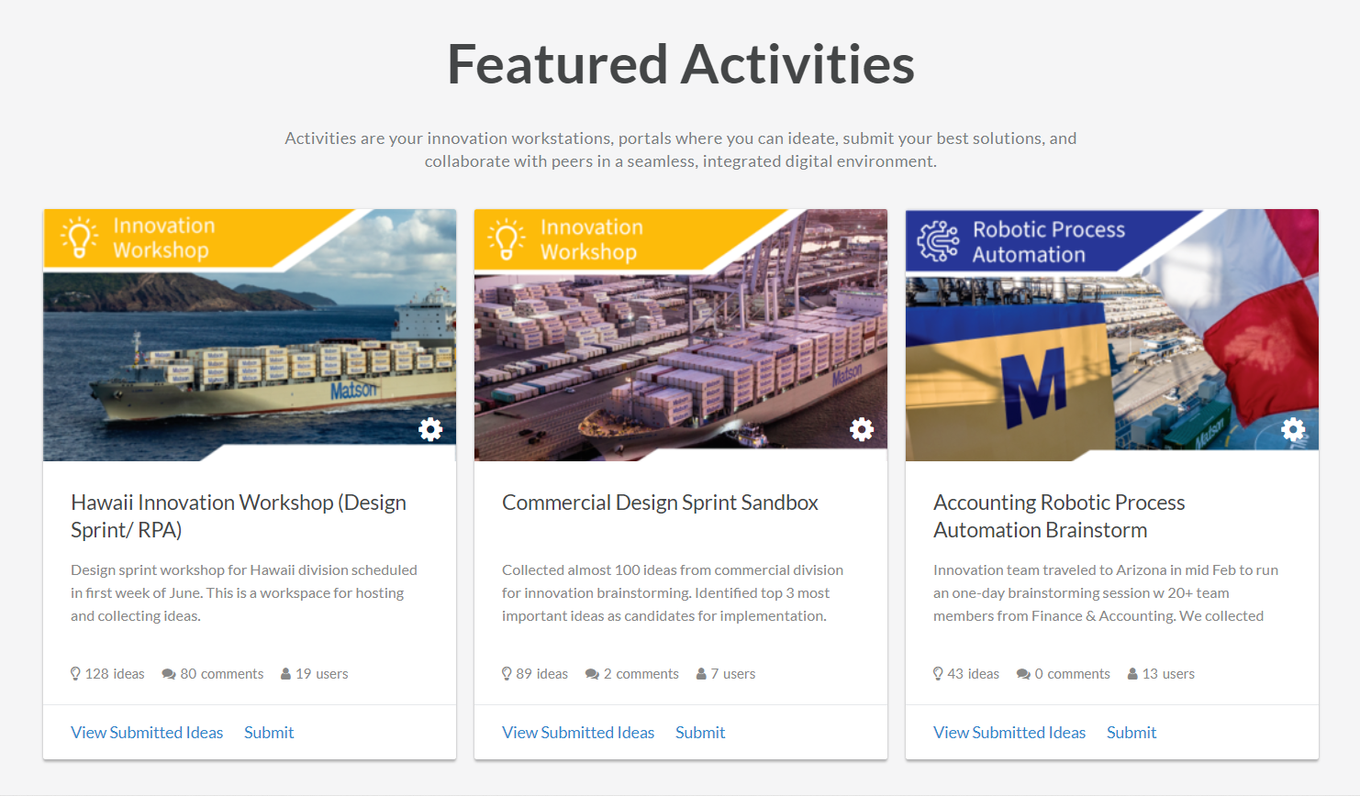
Log into BrightIdea
Matson - Innovation: Enterprise Home (brightidea.com)
Log into BrightIdea
CClick the Hawaii Innovation Workshop initiative sandbox.

Slide 3

Click Browse

Slide 4
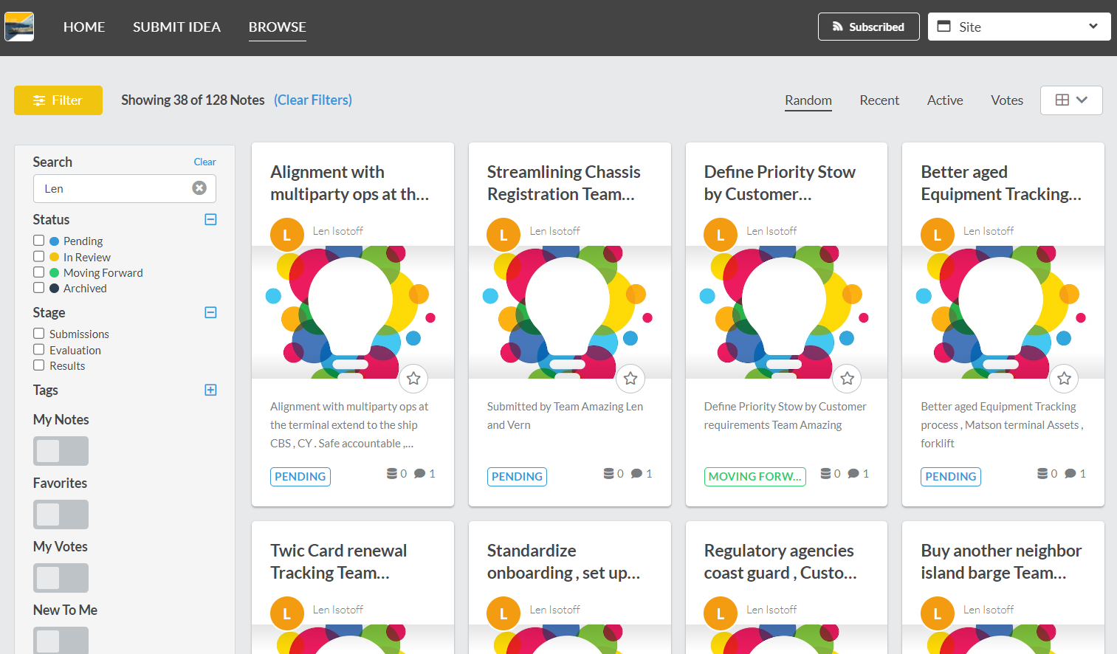
Search your ideas by team leaders’ name
Search your team leader’s name to filter out a list of ideas from your team

Slide 5
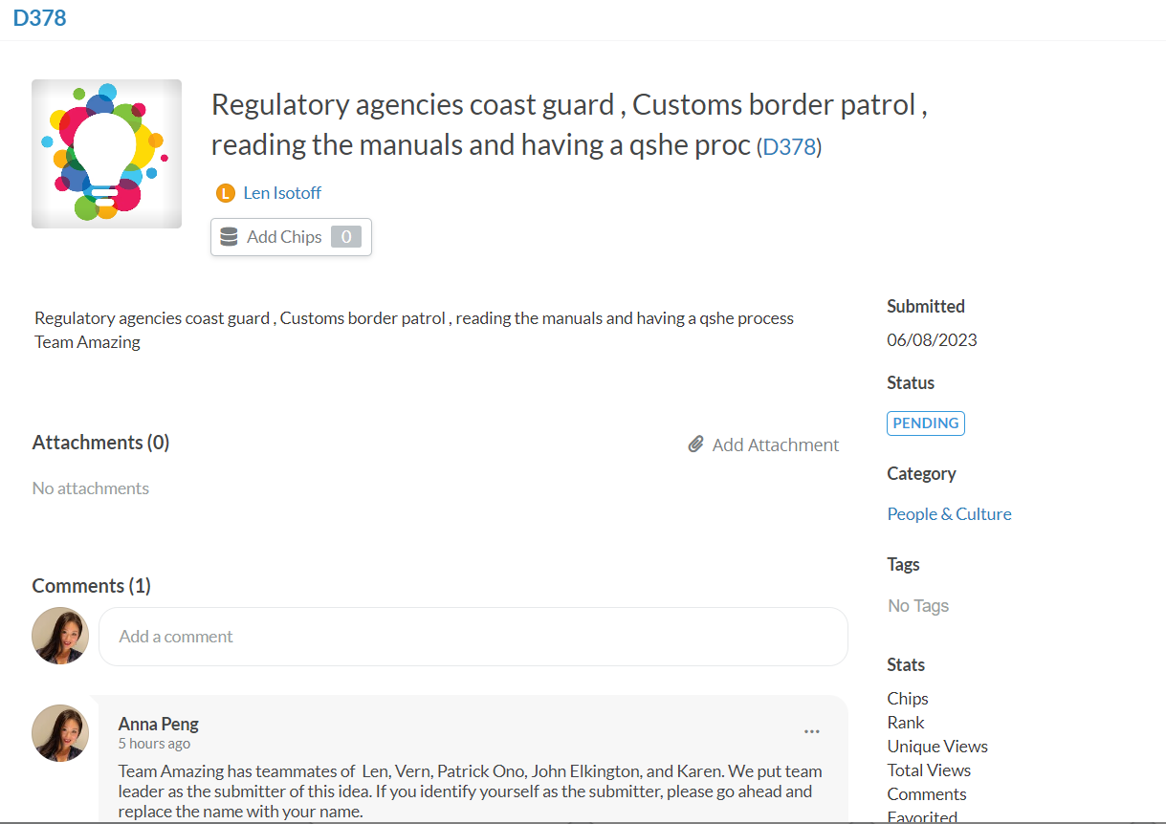
Make Changes to Your Idea
Once you identified your ideas, you can do the following:
Replace the team leader name w your name
Add attachments to add contexts
Leave comments on your or other ideas

Slide 6
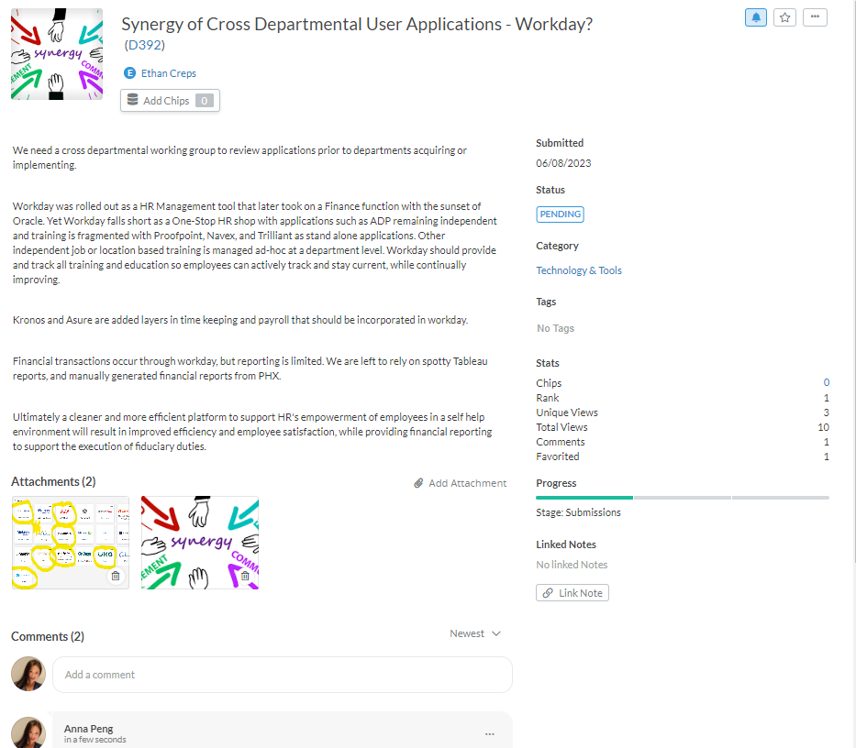
An Example from Your Colleague
Here is an example idea submitted by Ethan completed w screenshots, description, and supporting materials as attachments and comments.

